Slide 1
Writing JavaDoc Comments

Slide 2
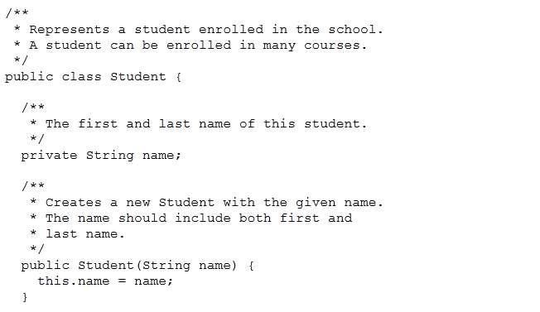
/**
Javadoc comments are any multi-line comments ("/** ... */") that are placed before class, field, or method declarations.

Slide 3
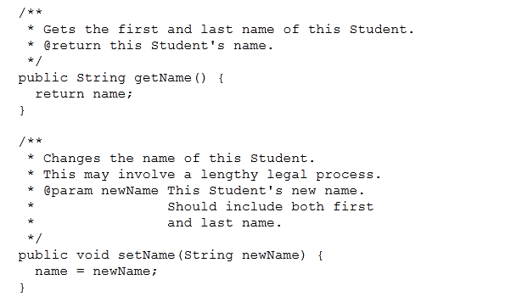
"@param" and "@return" tags

Slide 4
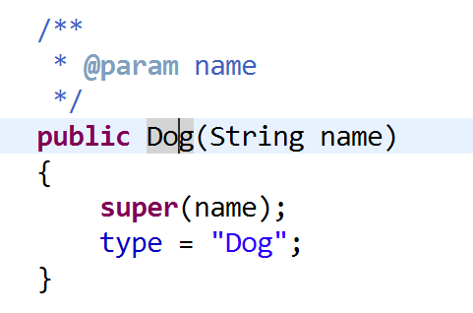
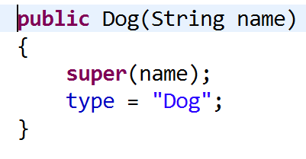
Shift-Alt-J
keyboard shortcut in Eclipse for creating Javadoc comment templates

Slide 5
Generate docs for a whole class
go to the Package Explorer View
expand the class you want to generate comments on (open each method)
select all the opened elements in the class from that Package Explorer Tree (use shift click)
alt+shift+J : comments skeleton generated on the class, and every method- you fill in details

Slide 6
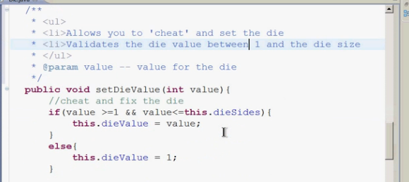
Add html tags for layout

Slide 7
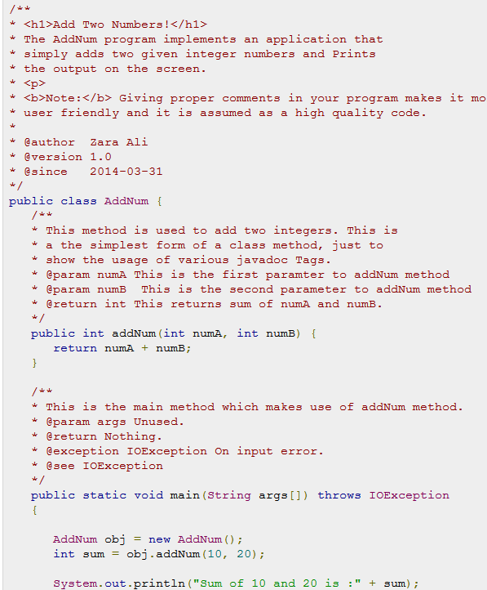

Slide 8
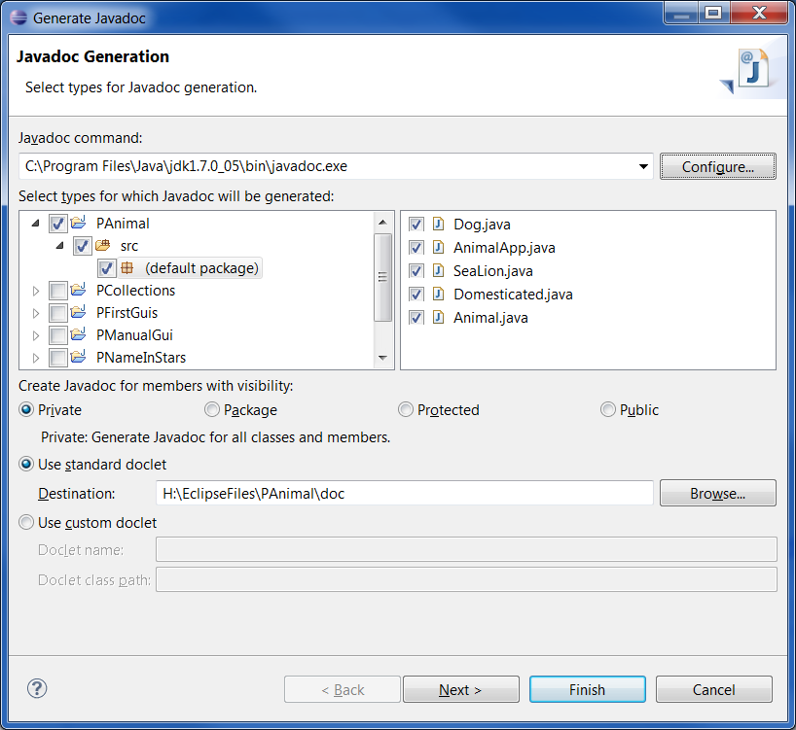
Generate the html documentation files Project|Generate JavaDoc
You have to find the path to javadoc.exe

Slide 9
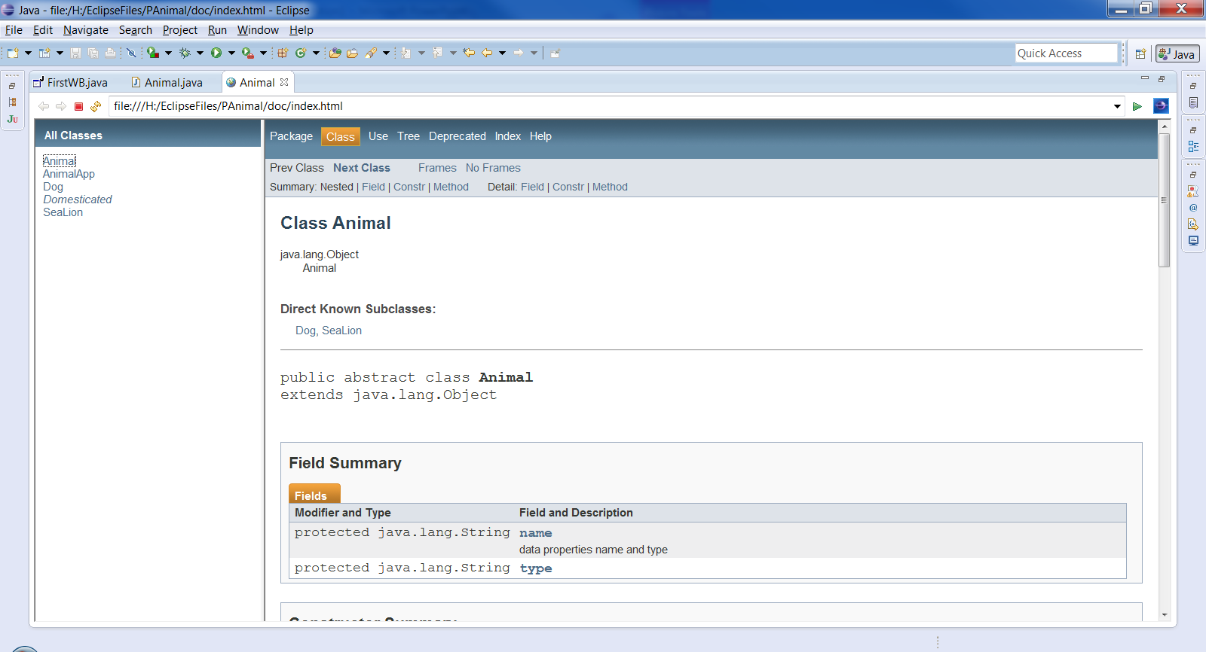
Html help files

